Slide 1
Inventory Management System
Names of People

Slide 2
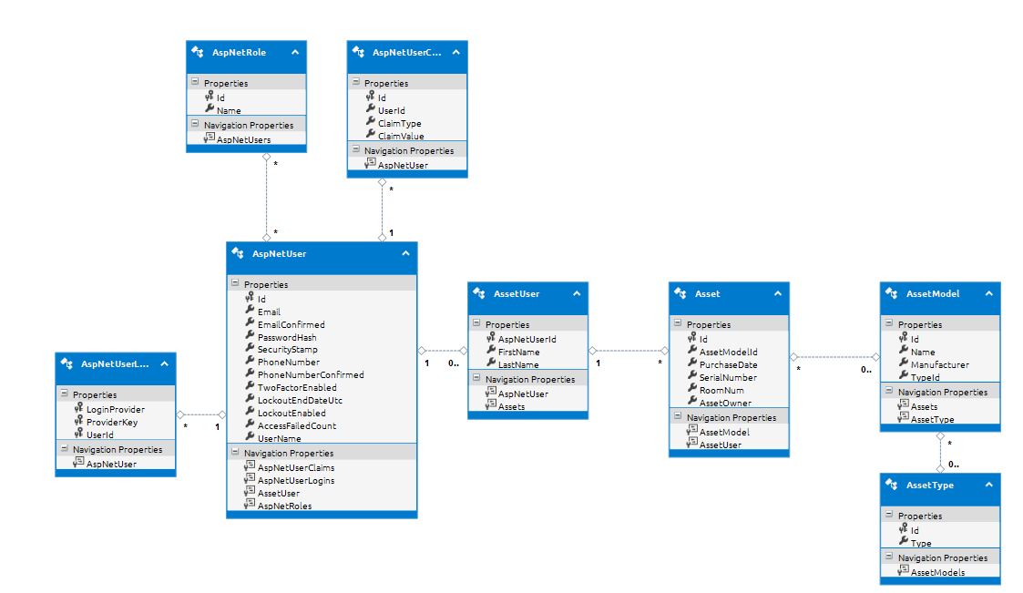
Class Model/EDMX
Notes:
AssetUser is a join table between AspNetUser and Asset so we don’t alter anything in AspNetUser. Users have Assets and Assets have Models and Models have Type

Slide 3
Asset Search

Slide 4
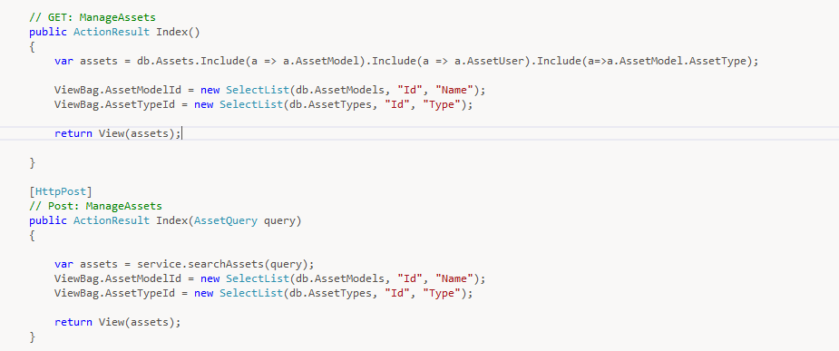
Controller

Slide 5
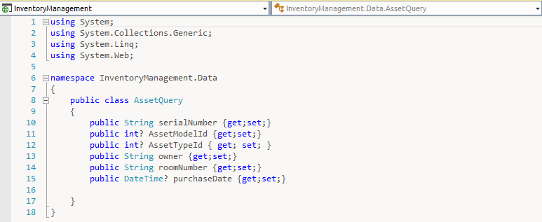
Query Class

Slide 6
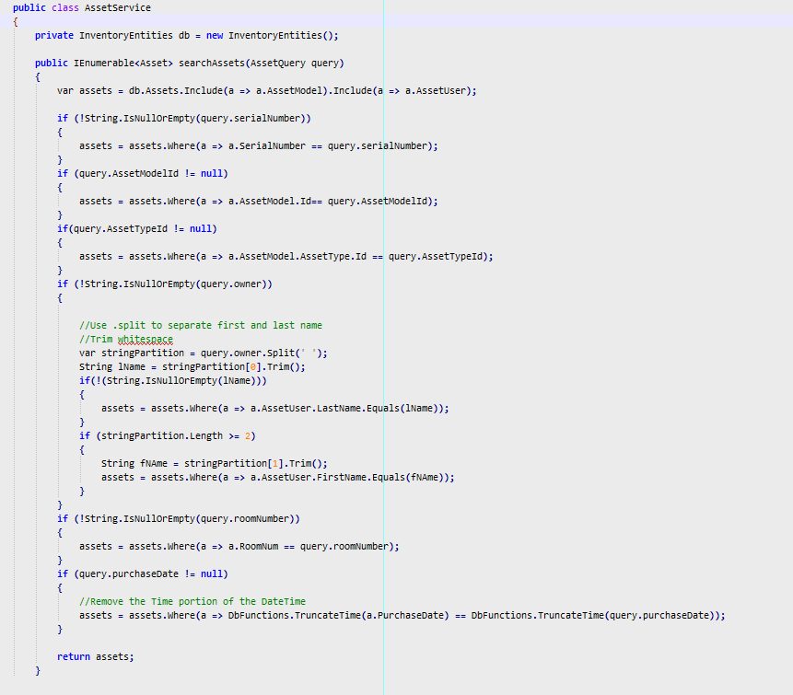
Search Logic

Slide 7
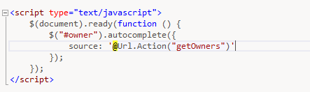
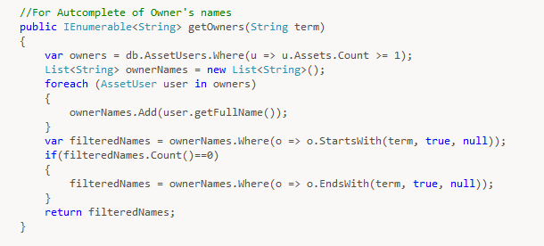
Autocomplete

Slide 8
Edit

Slide 9
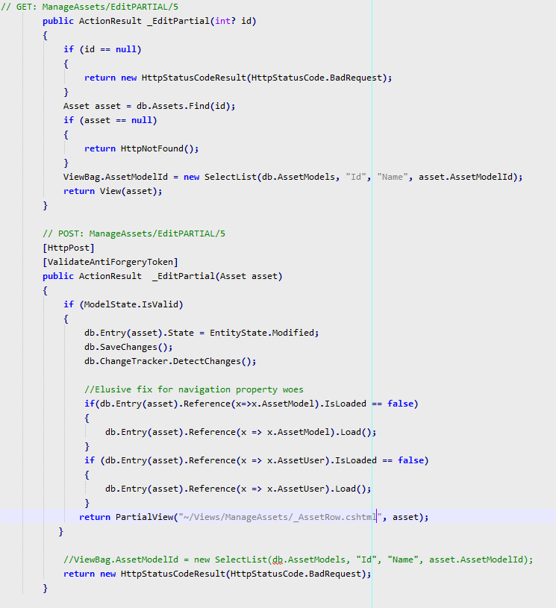
Controller

Slide 10
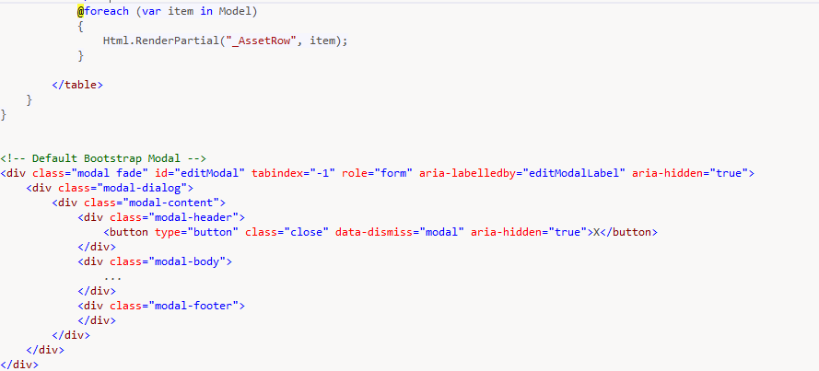
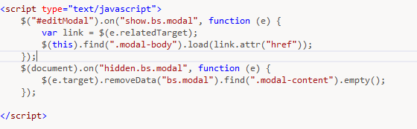
View – Partial Rows & Modal

Slide 11
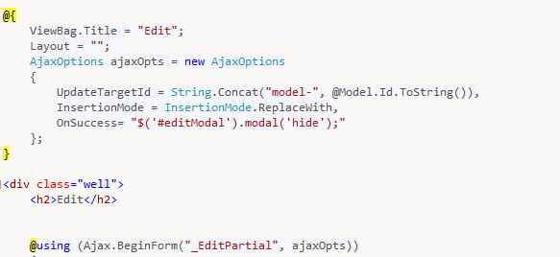
Ajax Form

Slide 12
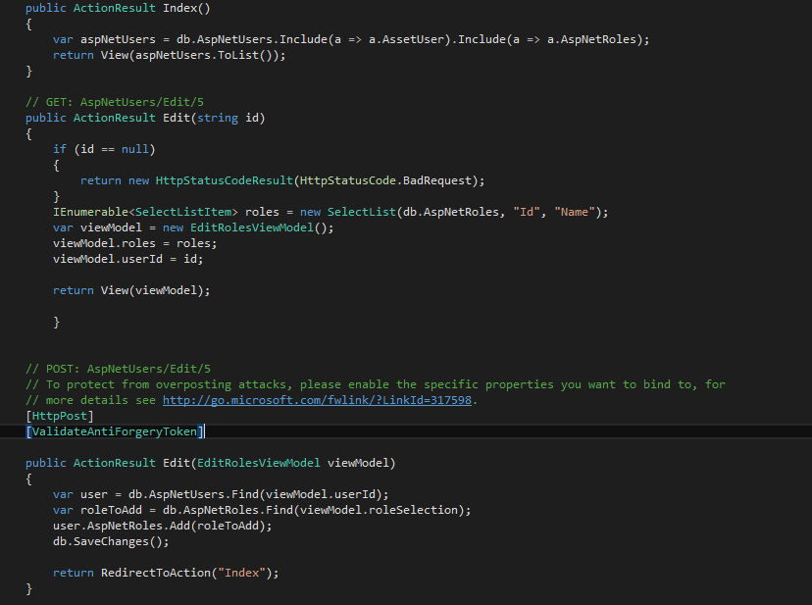
User Roles Page

